Slide 1
Reinforcement Learning

Slide 2
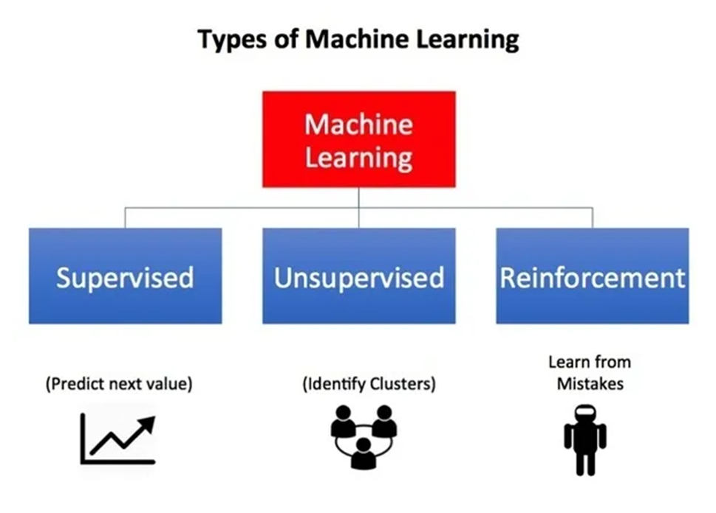

Slide 3
Introduction
Reinforcement Learning (RL) overcomes the problem of data acquisition.
In RL, the computer is simply given a goal to achieve.
The computer then learns how to achieve that goal by trial-and-error by interacting with its environment.
RL is a feedback-based Machine learning technique in which an agent learns based on this sensory input choosing an action to perform in the environment.
There is no labeled data, so the agent is bound to learn by its experience only.
By seeing the results of actions, the agent gets positive feedback for each good action, and for each bad action, the agent gets negative feedback or penalty.

Slide 4
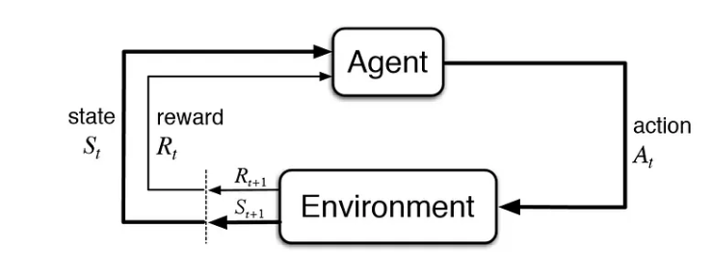
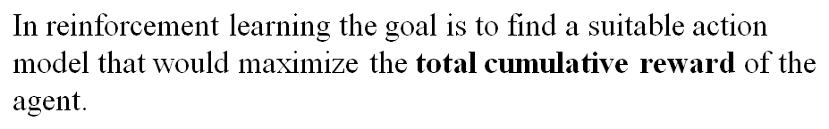
Formulation of a Basic RL Problem
The action changes the environment in some manner and this change is communicated to the agent through a scalar reinforcement signal(reward/penalty).

Slide 5
Different Key Terms
Agent: This is the algorithm/model that is going to perform the actions and learn over time.
Environment: The surroundings that the agent interacts with.
Action: This is what the agent performs. These are essentially the interactions of the agent in an environment.
Reward: This is the outcome of an action and every action has a reward. A reward could be positive or negative (penalty).
State: The current place of the agent in the environment. The actions that the agent performs can change its state.

Slide 6
The Environment
Every RL system learns a mapping from situations to actions by trial-and-error interactions with a dynamic environment.
This environment must at least be partially observable by the reinforcement learning system, and the observations may come in the form of sensor readings.
If the RL system can observe perfectly all the information in the environment that might influence the choice of action to perform, then the RL system chooses actions based on true “states” of the environment.
This ideal case is the best possible basis for reinforcement learning and, in fact, is a necessary condition for much of the associated theory.

Slide 7
Policy: A plan that directs the agent’s decision-making by mapping states to actions. Finding an ideal policy that maximises cumulative rewards is the objective.
The policies could be deterministic (maps state to action) or non-deterministic (probability distribution of actions for a state).
For deterministic policy: a_{t} = μ(s_{t}) For stochastic policy: a_{t} = π(. | s_{t}) = P[a_{t} =a | s_{t} = s]
Value Function: This function calculates the anticipated cumulative reward an agent can obtain from a specific state while adhering to a specific policy. It is beneficial in assessing and contrasting states and policies.
Model: A depiction of the dynamics of the environment that enables the agent to simulate potential results of actions and states. Models are useful for planning and forecasting.

Slide 8
The Reinforcement Function
The “goal” of the RL system is defined using the concept of a reinforcement function.
There exists a mapping from state/action pairs to reinforcements; after performing an action in a given state the RL agent will receive some reinforcement (reward) in the form of a scalar value.
The RL agent learns to perform actions that will maximize the sum of the reinforcements received when starting from some initial state and proceeding to a terminal state.
It is the job of the RL system designer to define a reinforcement function that properly defines the goals of the RL agent.

Slide 9
Optimal Reinforcement Function
Not always the learning agent attempts to maximize the reinforcement function.
The learning agent could just as easily learn to minimize the reinforcement function due to limited resources.
An alternative reinforcement function would be used in the context of a game environment, when there are two or more players with opposing goals.
In a game scenario, the RL system can learn to generate optimal behavior for the players involved by finding the maximin, minimax, or saddlepoint of the reinforcement function.

Slide 10
Optimal Value Function
Initially, the approximation of the optimal value function is poor.
V*(s_{t}) is the optimal value function where s_{t} is the state vector; V(s_{t}) is the approximation of the value function; γ is a discount factor in the range [0,1] that causes immediate reinforcement to have more importance.
V(s_{t}) will be initialized to random values and will contain no information about the optimal value function V*(s_{t}).
This means that the approximation of the optimal value function in a given state is equal to the true value of that state V*(s_{t}) plus some error in the approximation, as expressed
V(s_{t}) = e(s_{t}) +V*(s_{t})
where e(s_{t}) is the error in the approximation of the value of the state occupied at time t.
Likewise
V(s_{t+1}) = e(s_{t+1}) +V*(s_{t+1})

Slide 11
Bellman Equation
The value of state s_{t} for the optimal policy is the sum of the reinforcement signal when starting from state s_{t} and performing optimal actions until a terminal state is reached.
By this definition, a simple relationship exists between the values of successive states, s_{t} and s_{t} ₊₁ and defined by the Bellman equation as
V*(s_{t}) = r(s_{t}) + γV*(s_{t+1})
where the discount factor γ is used to exponentially decrease the weight of reinforcements received in the future.
The approximation V(s_{t}) also has the same relationship,
V(s_{t}) = r(s_{t}) + γV(s_{t+1})
e(s_{t}) + V*(s_{t}) = r(s_{t}) + γ(e(s_{t+1}) + V*(s_{t+1}))
e(s_{t}) + V*(s_{t}) = r(s_{t}) + γe(s_{t+1}) + γV*(s_{t+1}))
V*(s_{t}) is subtracted from both sides to reveal the relationship in the errors of successive states. This relationship is expressed
e(s_{t}) = γe(s_{t+1})

Slide 12
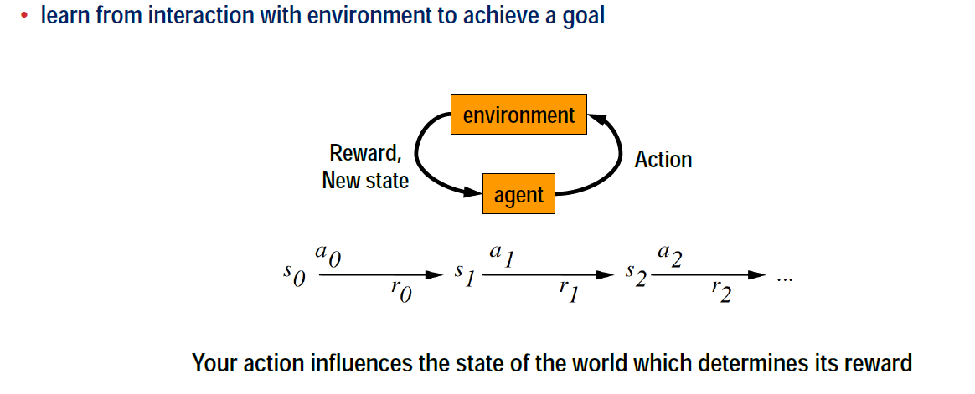
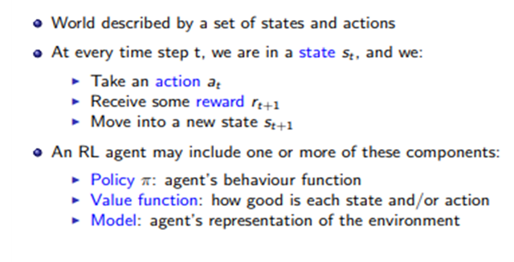
Formulating Reinforcement Learning

Slide 13
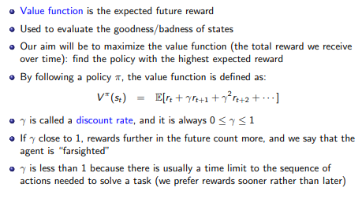

Value Function

Slide 14
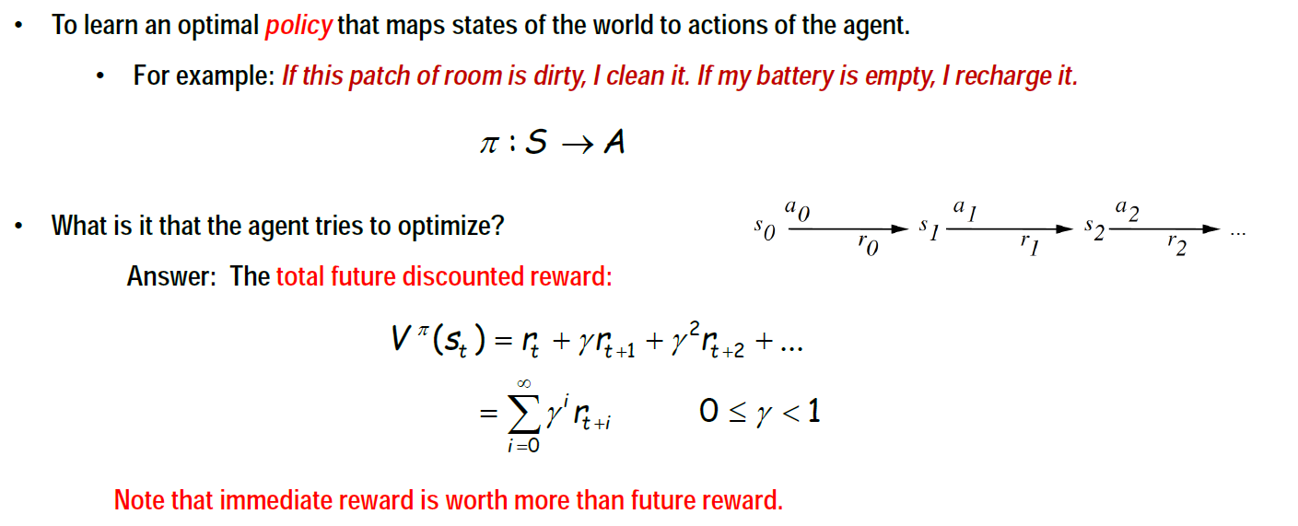
The Task
V^{π}(s_{t}) is the optimal value function where s_{t} is the state vector; γ is a discount factor in the range [0,1] that causes immediate reinforcement to have more importance (weighted more heavily) than future reinforcement.

Slide 15
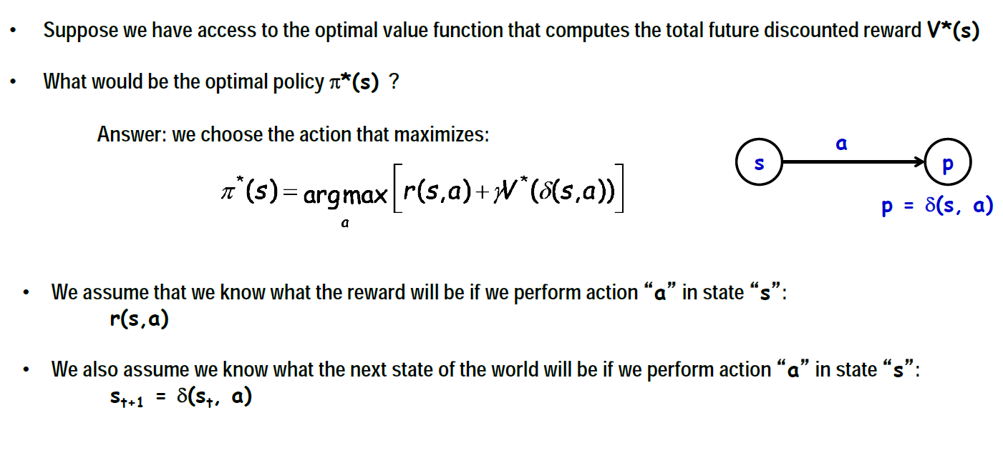
Optimal Policy

Slide 16
Learning
Reinforcement learning is a difficult problem because the learning system may perform an action and not be told whether that action was good or bad.
It will have to make many decisions and then acting on such decisions and the system learn from this experience.
In the future, any time it chooses an action that leads to this particular situation, it will immediately learn that particular action is bad or good.
The primary objective of learning is to find the correct mapping. Once this is completed, the optimal policy can easily be extracted.

Slide 17

Markov Decision Process
The Markov decision process (MDP) is a mathematical framework used for modeling decision-making problems where the outcomes are partly random and partly controllable.
It’s a framework that can address most reinforcement learning (RL) problems.
According to the Markov property, the current state of the robot depends only on its immediate previous state (or the previous time step).
Formally, for a state S_{t} to be Markov, the probability of the next state S_{(t+1)} being s′ should only be dependent on the current state S_{t}

Slide 18
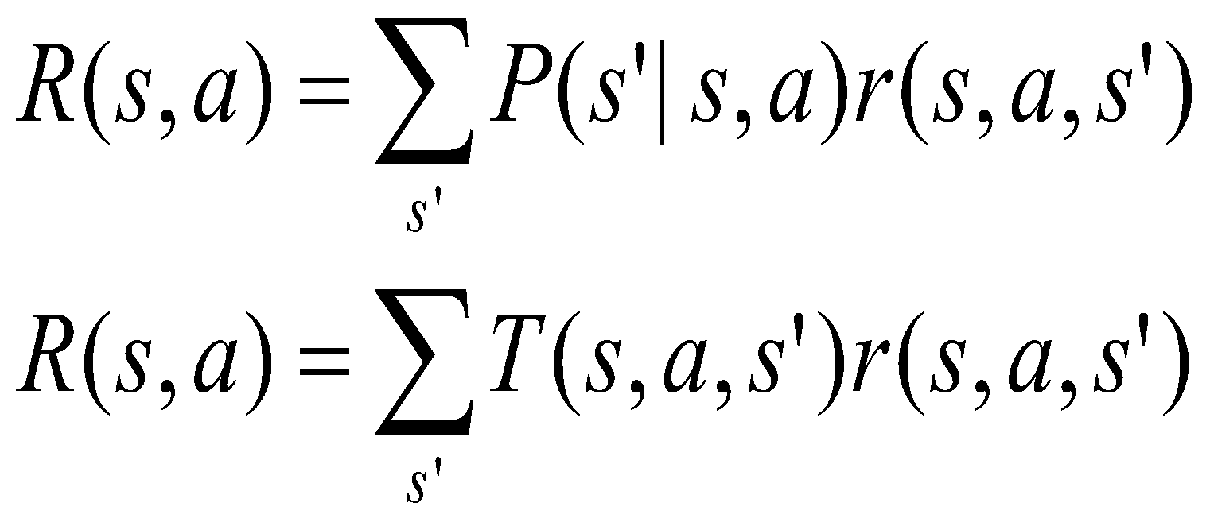

MDP Model
S– set of states
A– set of actions
T(s,a,s’) = P(s’|s,a)– the probability of transition from s to s’ given action a
R(s,a)– the expected reward for taking action a in state s
MDP model <S,T,A,R>
Agent
State
Action
Reward
Environment
a₀
a₁
a₂
s₀
s₁
s₂
s₃
r₀
r1
r2

Slide 19
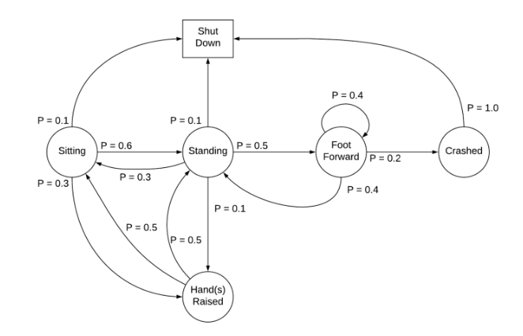
A Markov process is defined by (S, P) where S are the states, and P is the state-transition probability.
It consists of a sequence of random states S₁, S₂, … where all the states obey the Markov property.
The state transition probability or P_{ss′} is the probability of jumping to a state s’ from the current state s.
Markov chain

Slide 20
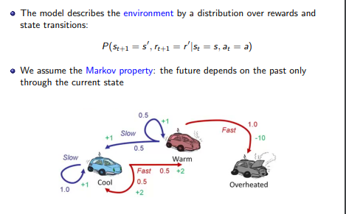

Slide 21
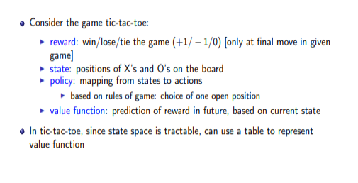
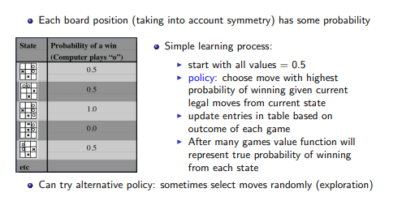

Slide 22
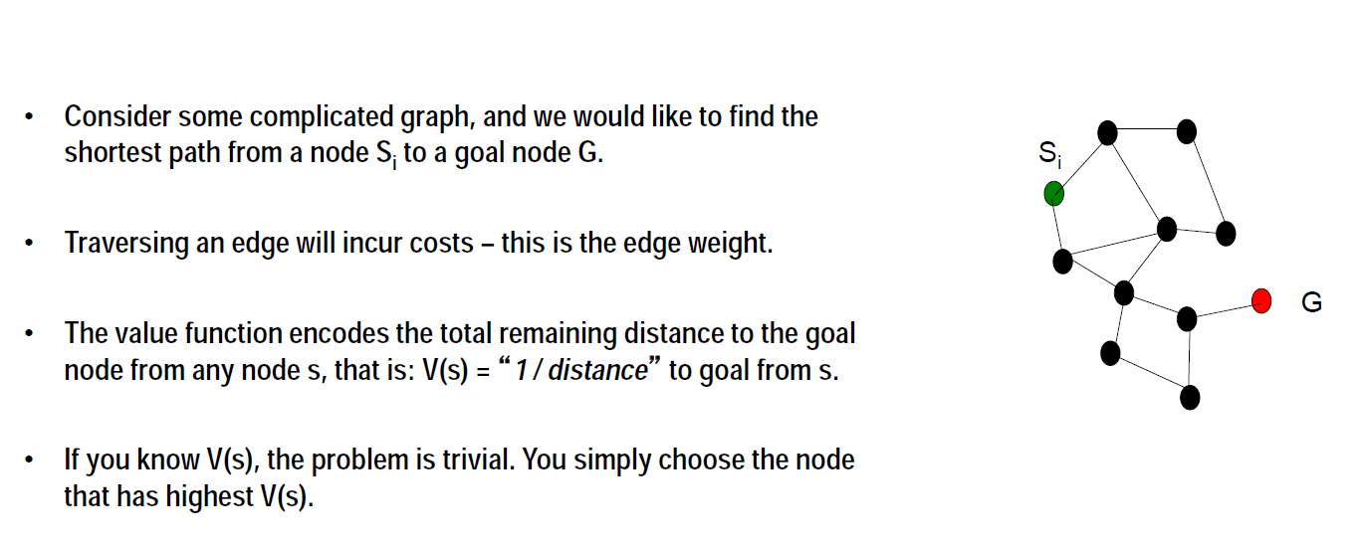
Example 1

Slide 23
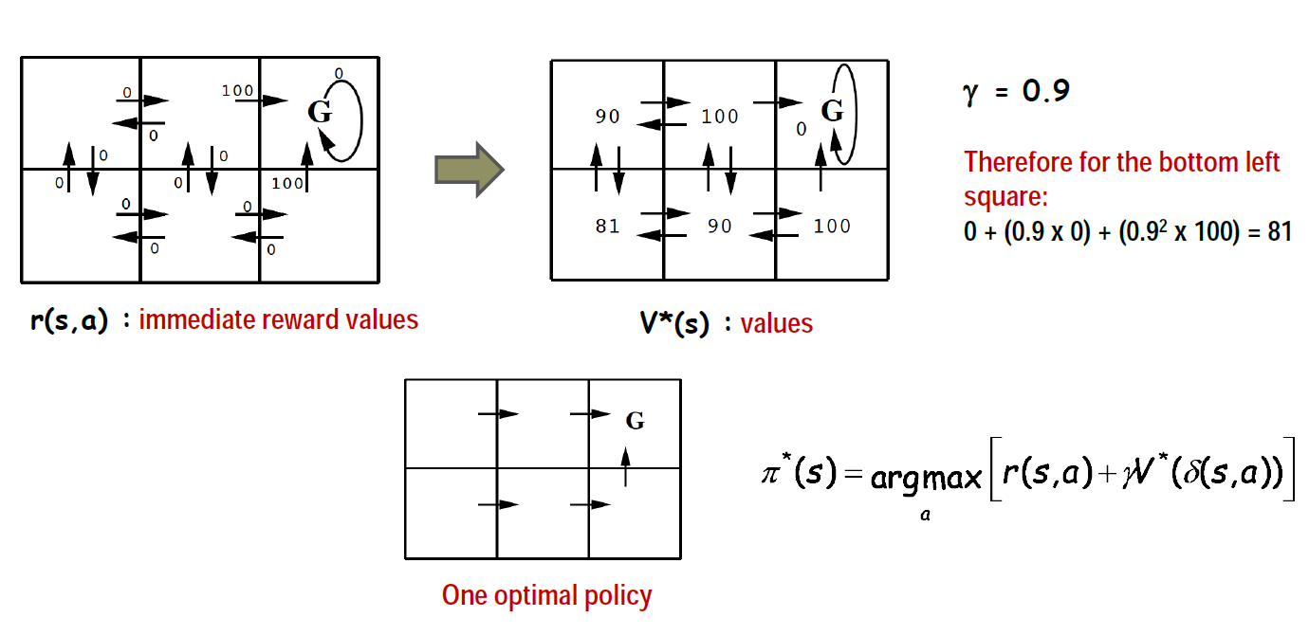
Example 2

